Slide 1
Equivalent Circuits for L and C
with Initial Conditions
Linear Circuit Analysis II
EECE 202 – Spring 2025

Slide 2
Announcement
GCA2 – Group Week 11 Lecture 2
PD2 due Week 12

Slide 3
Recap
Transfer function revision
Stability in s-plane
Effect of pole location
New Material
Equivalent circuit for capacitors in s domain
Equivalent circuit for Inductors in s domain
Examples

Slide 4
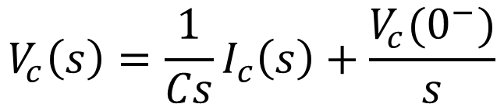
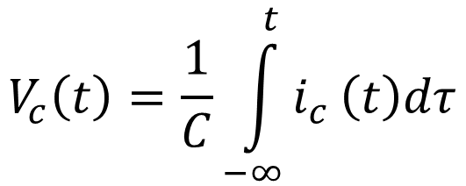
Equivalent circuit in s domain for a Capacitor
In case of non-zero initial condition v_{c}(0⁻)
$$V_{c}\left(t\right)=\frac{1}{C}\int_{−∞}^{t}{i_{c}}\left(t\right)dτ$$
$$V_{c}\left(s\right)=\frac{1}{Cs}I_{c}\left(s\right)+\frac{V_{c}(0^{−})}{s}$$
impedance
Notes:
Refer to page 618-619.

Slide 5
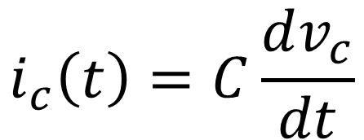

Equivalent circuit in s domain for a Capacitor
In case of non-zero initial condition v_{c}(0⁻)
$$i_{c}\left(t\right)=C\frac{dv_{c}}{dt}$$
$$I_{c}\left(s\right)={CsV}_{c}\left(s\right) −Cv_{c}(0^{−})$$
admittance

Slide 6
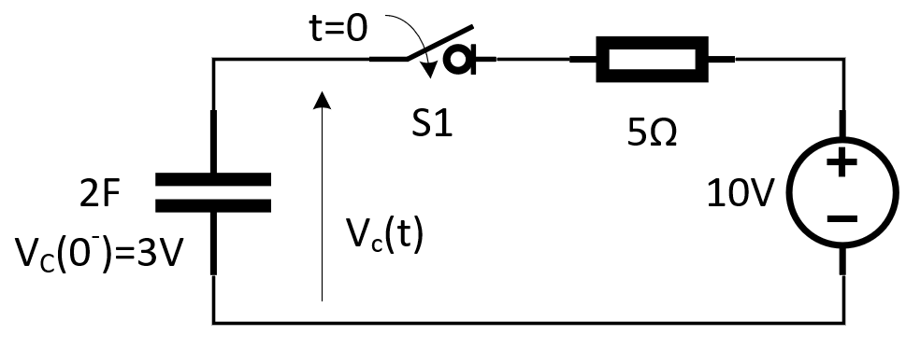
The Capacitor
Meaning of the initial conditions:
For the circuit shown in Figure 1, the capacitor was already charged before the switch (S1) closes at time (t=0).
This charge makes the voltage across the capacitor equals 3V.
Mathematically, we write this voltage as V_{c}(0⁻) = 3V, where “0⁻” means the time just before “t=0”.
Figure 1

Slide 7
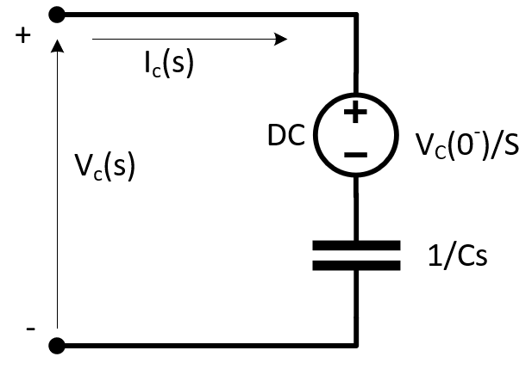
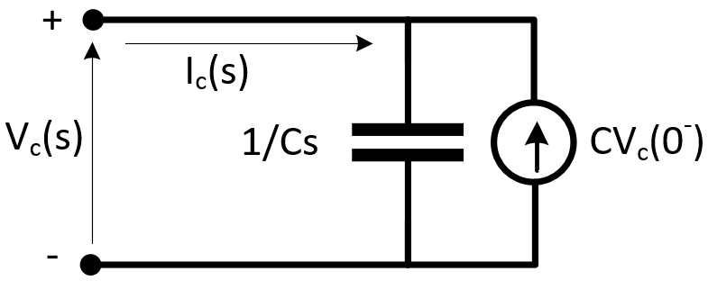
The Capacitor
Representation of the Capacitor in the Laplace “S” domain:
The first way “Series”:
We put a voltage source in series with the capacitor as shown in Figure 2. The value of this voltage source, in this case, equals V_{c}(0⁻). Accordingly, this voltage source is represented in the “S” domain as V_{c}(0⁻)/s. The capacitor is represented as we learned before as 1/Cs .
Figure 2
The second way “Parallel”:
We put a current source in parallel with the capacitor as shown in Figure 3. The value of this current source, in this case, equals “CV_{c}(0⁻)” in the “S” domain. Additionally, the capacitor is represented as we learned before as 1/Cs
Figure 3

Slide 8
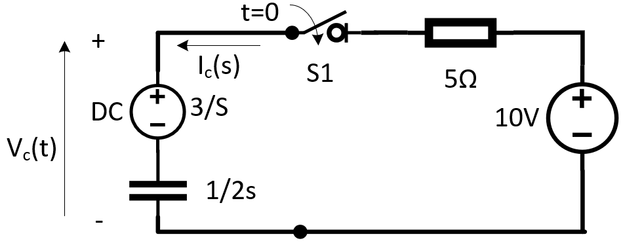
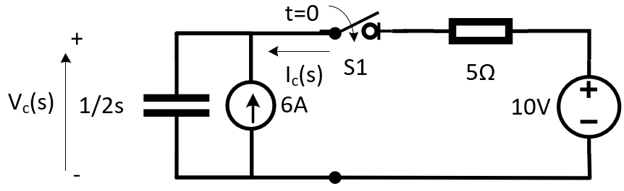
The circuit in Figure 4 will be represented in the “S” domain as either one of the below circuits:
Figure 4
Or

Slide 9
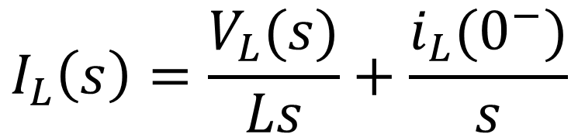
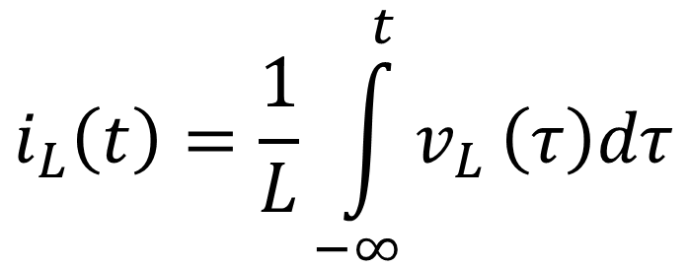
Equivalent circuit in s domain for an Inductor
In case of non-zero initial condition i_{L}(0⁻)
$$i_{L}\left(t\right)=\frac{1}{L}\int_{−∞}^{t}{v_{L}}\left(τ\right)dτ$$
$$I_{L}\left(s\right)=\frac{V_{L}(s)}{Ls}+\frac{i_{L}(0^{−})}{s}$$
impedance
Notes:
Refer to page 619-620

Slide 10
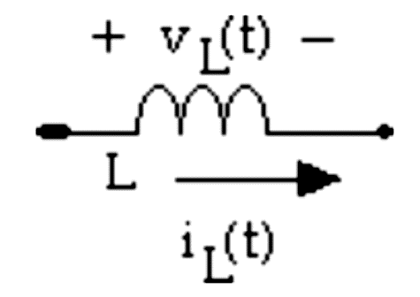
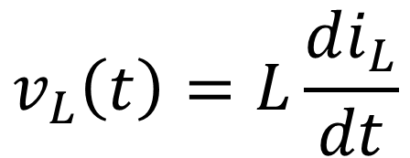

Equivalent circuit in s domain for an Inductor
In case of non-zero initial condition i_{L}(0⁻)
$$v_{L}\left(t\right)=L\frac{di_{L}}{dt}$$
$$V_{L}\left(s\right)={LsI}_{L}\left(s\right) −LI_{L}(0^{−})$$
s
impedance

Slide 11
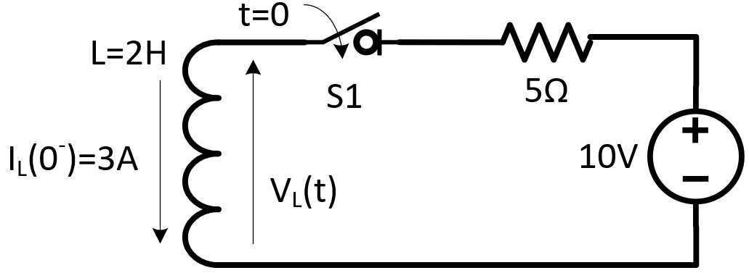
The inductor
Meaning of the initial conditions:
For the circuit shown in Figure 5, there was a current passing through the inductor before the switch (S1) closes at time (t=0).
The value of this current equals 3V.
Mathematically, we write this current as i_{L}(0⁻) = 3A, where “0⁻” means the time just before “t=0”
Figure 5

Slide 12
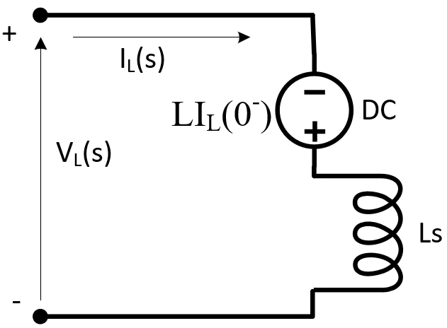
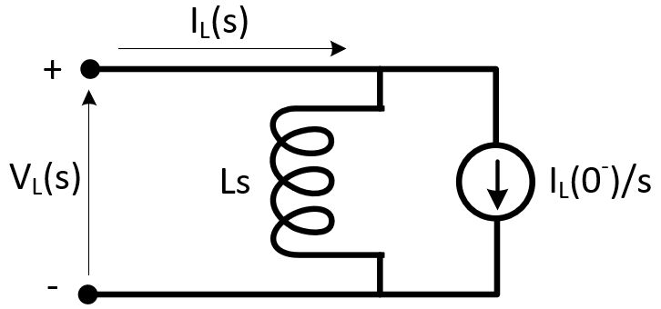
The inductor
Representation of the Inductor in the Laplace “S” domain:
The first way “Series”:
We put a voltage source in series with the inductor as shown in Figure 6. The value of this voltage source, in this case, equals “LI_{L}(0⁻)” in the “S” domain. The inductor itself is represented as we learned before as “Ls” .
The second way “Parallel”:
We put a current source in parallel with the capacitor as shown in Figure 7. The value of this current source, in this case, equals I_{L}(0⁻)/s in the “S” domain. Additionally, the inductor is represented as we learned before as “Ls”.
Figure 6
Figure 7

Slide 13
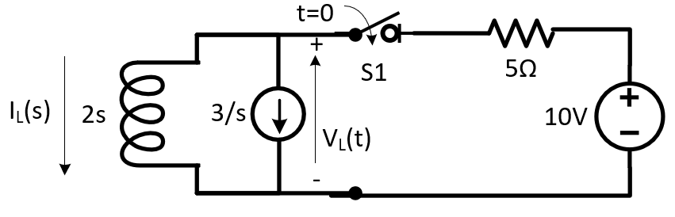
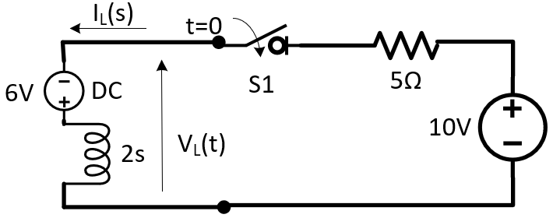
The circuit in Figure 8 will be represented in the “S” domain as either one of the below circuits:
Figure 8

Slide 14
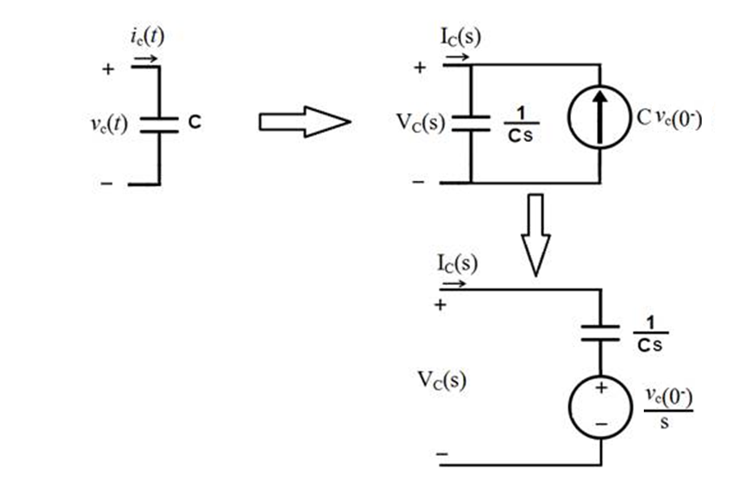
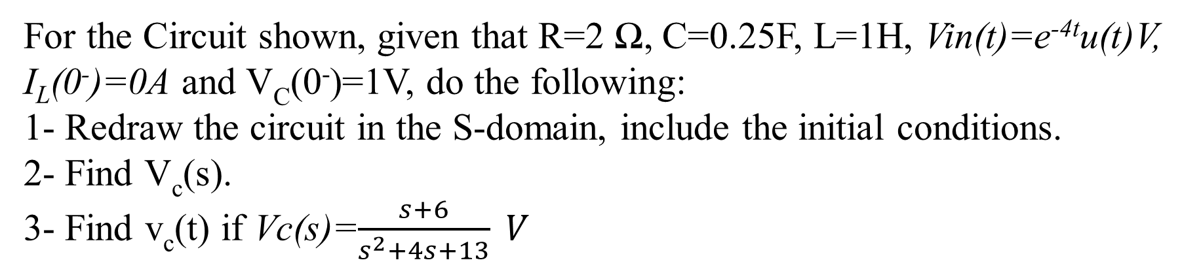
Example -1
For the Circuit shown, given that R=2 Ω, C=0.25F, L=1H, Vin(t)=e^{-4t}u(t)V, I_{L}(0⁻)=0A and V_{C}(0⁻)=1V, do the following:
1- Redraw the circuit in the S-domain, include the initial conditions.
2- Find V_{c}(s).
3- Find v_{c}(t) if Vc(s)=$\frac{s+6}{s^{2}+4s+13} V$

Slide 15
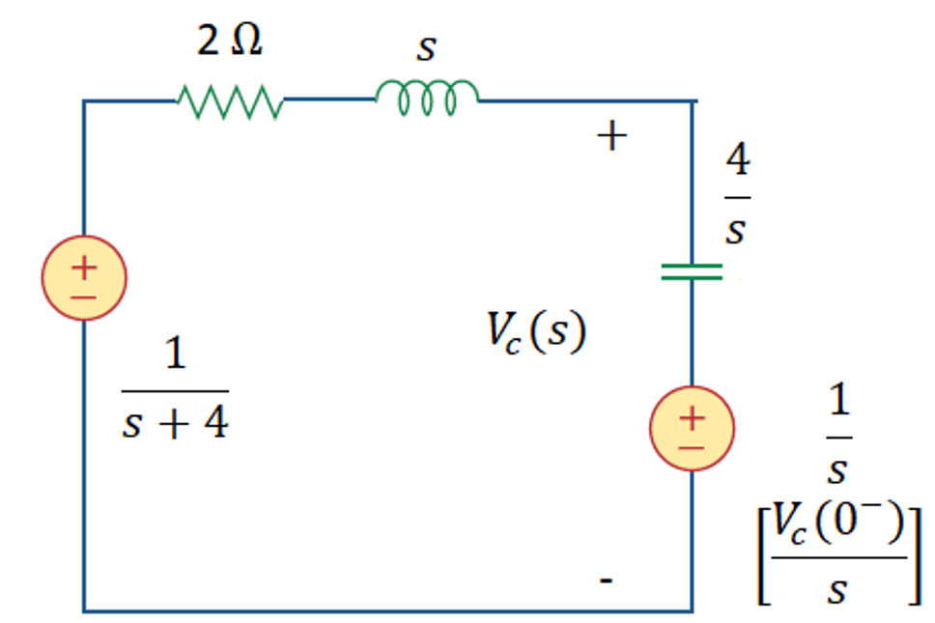
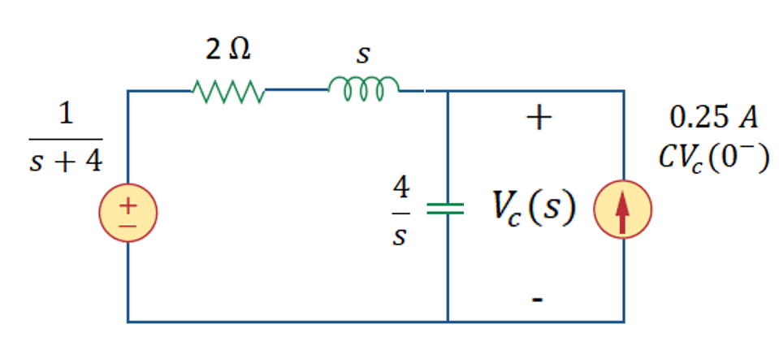
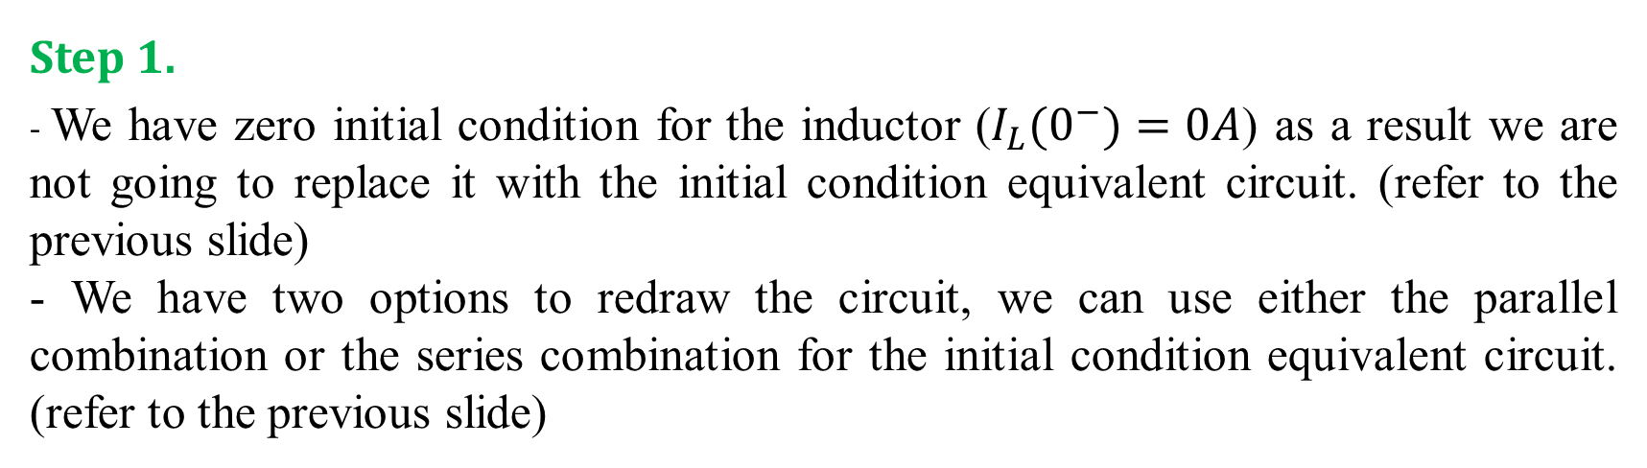
Step 1.
- We have zero initial condition for the inductor ($I_{L}(0^{−})=0A$) as a result we are not going to replace it with the initial condition equivalent circuit. (refer to the previous slide)
- We have two options to redraw the circuit, we can use either the parallel combination or the series combination for the initial condition equivalent circuit. (refer to the previous slide)
It is based on your preference to choose which circuit to work on. Please choose the circuit that makes you analysis easier and short.
Notes:
Maybe just show the steps, one by one, and do the calculation on the board. This applies to the slides 9-13 showing the calculation of this example.

Slide 16
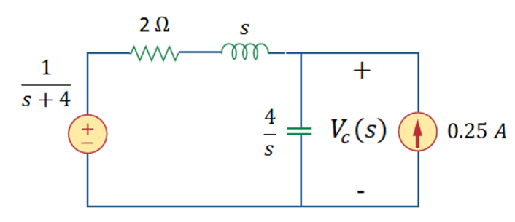
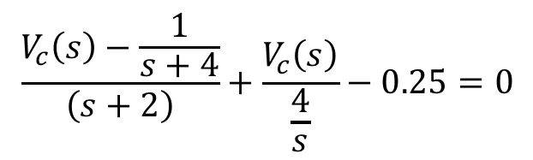
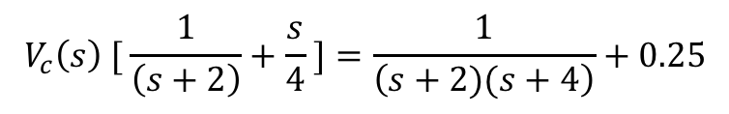

Step 2.
Let’s use nodal analysis as the required signal is Vc(s), we have one node to analyze Vc(s), which results in one equation. Write a single node equation and solve for V_{C} (s)
$$\frac{V_{c}\left(s\right)−\frac{1}{s+4}}{\left(s+2\right)}+\frac{V_{c}\left(s\right)}{\frac{4}{s}}−0.25=0$$
Isolate $V_{c}\left(s\right)$ on one side, the rest of terms should go to the other side.
$$\frac{V_{c}\left(s\right)}{(s+2)}−\frac{1}{(s+2)(s+4)}+\frac{sV_{c}\left(s\right)}{4}−0.25=0$$
$$V_{c}\left(s\right) [ \frac{1}{\left(s+2\right)}+\frac{s}{4} ]=\frac{1}{\left(s+2)(s+4\right)}+0.25$$
Apply common denominator to the left-hand side, no need to do it to the right-hand side as we will be doing partial fraction later on anyways (you can do it if you want).

Slide 17
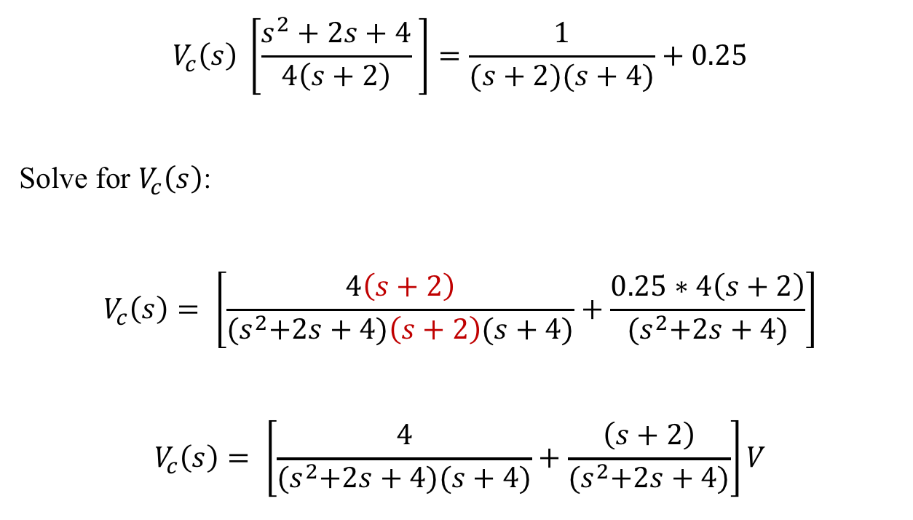
$$V_{c}\left(s\right) \left[\frac{s^{2}+2s+4}{4\left(s+2\right)} \right]=\frac{1}{(s+2)(s+4)}+0.25$$
Solve for $V_{c}\left(s\right)$:
$$V_{c}\left(s\right)= \left[\frac{4\left(s+2\right)}{{(s}^{2}+2s+4)\left(s+2\right)(s+4)}+\frac{0.25∗4\left(s+2\right)}{{(s}^{2}+2s+4)}\right]$$
$$V_{c}\left(s\right)= \left[\frac{4}{{(s}^{2}+2s+4)(s+4)}+\frac{\left(s+2\right)}{{(s}^{2}+2s+4)}\right]V$$

Slide 18
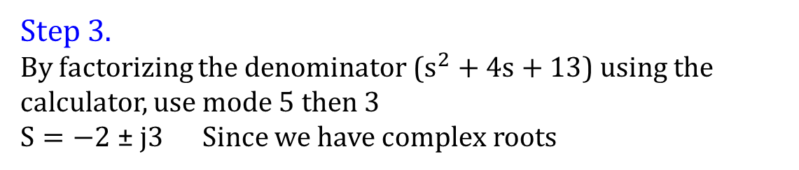
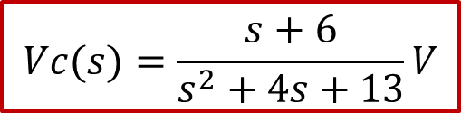
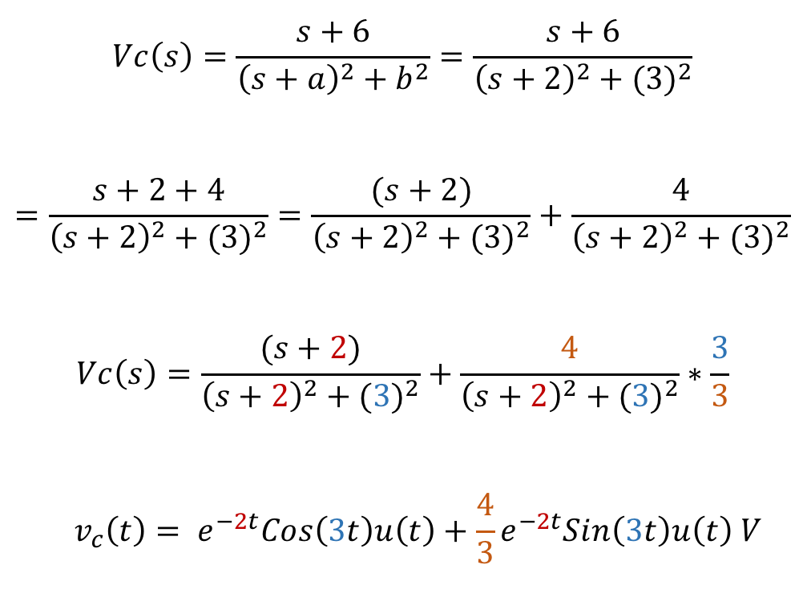
Step 3.
By factorizing the denominator ($s^{2}+4s+13$) using the calculator, use mode 5 then 3
$S=−2$± $j3$ Since we have complex roots
a=2
b=3
$$Vc\left(s\right)=\frac{s+6}{{\left(s+a\right)}^{2}+b^{2}}=\frac{s+6}{{\left(s+2\right)}^{2}+{(3)}^{2}}$$
$$=\frac{s+2+4}{{\left(s+2\right)}^{2}+{(3)}^{2}}=\frac{(s+2)}{{\left(s+2\right)}^{2}+{(3)}^{2}}+\frac{4}{{\left(s+2\right)}^{2}+{(3)}^{2}}$$
$$Vc\left(s\right)=\frac{(s+2)}{{\left(s+2\right)}^{2}+{(3)}^{2}}+\frac{4}{{\left(s+2\right)}^{2}+{(3)}^{2}}∗\frac{3}{3}$$
$$v_{c}\left(t\right)= e^{−2t}Cos\left(3t\right)u\left(t\right)+\frac{4}{3}e^{−2t}Sin\left(3t\right)u\left(t\right) V$$
$$Vc(s)=\frac{s+6}{s^{2}+4s+13}V$$
Apply inverse Laplace Transform

Slide 19
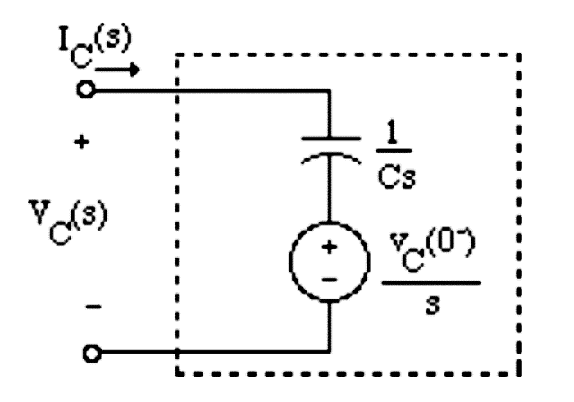
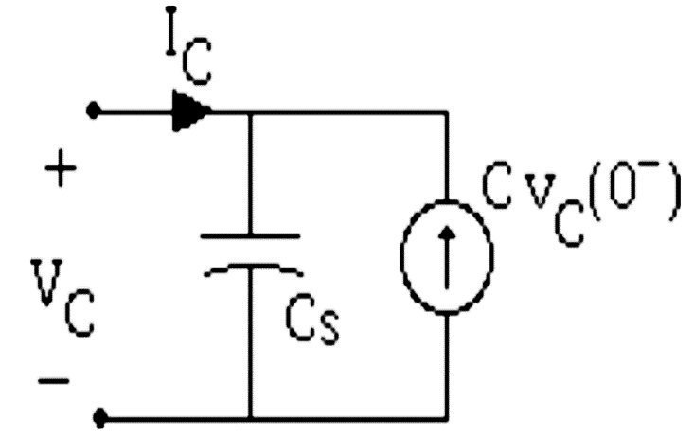
Example -2
Find V_{C} (s) in the following circuit in terms of R, L, C and Vin(s), consider the initial conditions.
Notes:
This is example 13.7 on page 622. It can be used. Revise the pictures because of the resolution.

Slide 20
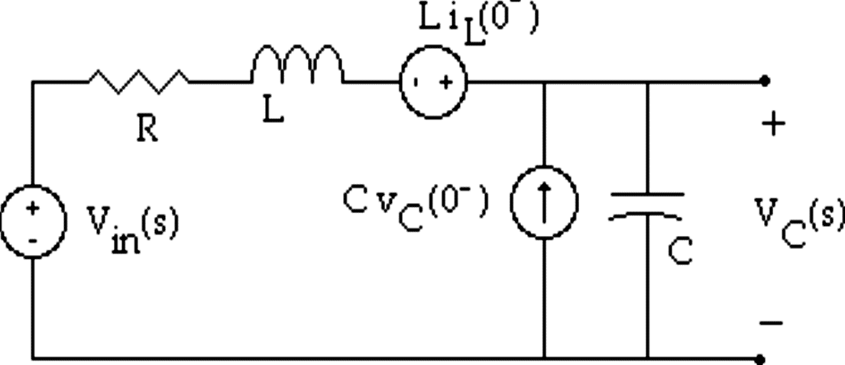
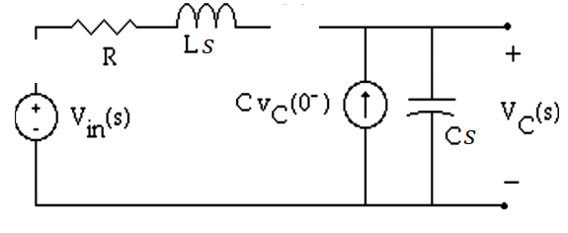




Step 1.
Draw equivalent circuits accounting for Initial conditions in the s domain.
$$s$$
$$s$$
Move the voltage source associated with the inductor to the left so that there are two voltage sources driving the circuit.
Notes:
Maybe just show the steps, one by one, and do the calculation on the board. This applies to the slides 9-13 showing the calculation of this example.

Slide 21
Step 2.
Write a single node equation and solve for V_{C} (s)

Slide 22
SALMAN
Step 2.
Write a single node equation and solve for V_{C} (s)
$$\frac{1}{Ls+R}\left(Vc −Vin −LiL\left(0−\right)\right)−CvC\left(0−\right)+CsVc=0$$
$\left[\frac{LCs2+CRs+1}{Ls+R}\right]Vc= \frac{1}{Ls+R}Vin+ \frac{1}{Ls+R} LiL \left(0−\right)+CvC$(0⁻)

Slide 24
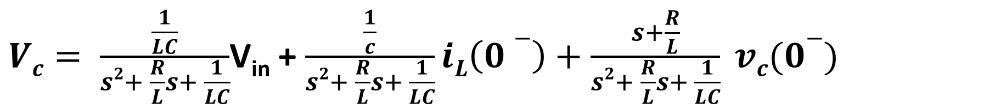
salman
$Vc= \frac{\frac{1}{LC}}{s2+ \frac{R}{L}s+ \frac{1}{LC}}$V_{in} + $\frac{\frac{1}{c}}{s2+ \frac{R}{L}s+ \frac{1}{LC}}iL\left(0−\right)+\frac{s+\frac{R}{L}}{s2+ \frac{R}{L}s+ \frac{1}{LC}} vc(0−)$

Slide 25
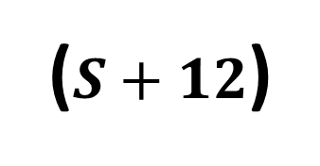
Example -2 cont.
Given that R = 2 Ω, C = 0.25 F, L = 0.25 H, v_{in}(t) = (1− e^{−4t} )u(t), I_{L}(0)=1A and V_{C}(0)=1V. Compute v_{C} (t).
4
($S+12$)

Slide 26

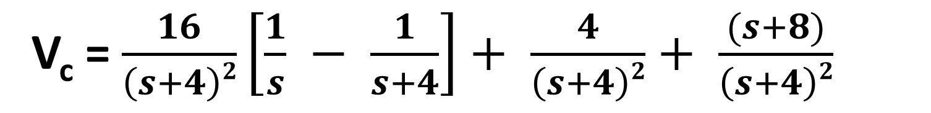
salman
Example -2 cont.
Given that R = 2 Ω, C = 0.25 F, L = 0.25 H, v_{in}(t) = (1− e^{−4t} )u(t), I_{L}(0)=1A and V_{C}(0)=1V. Compute v_{C} (t).
V_{c} = $\frac{16}{\left(s+4\right)2}\left[\frac{1}{s} − \frac{1}{s+4}\right]+ \frac{4}{\left(s+4\right)2}+ \frac{(s+8)}{\left(s+4\right)2}$
$$=\frac{16}{s\left(s+4\right)2}− \frac{16}{\left(s+4\right)3}+ \frac{(s+12)}{\left(s+4\right)2}$$

Slide 27
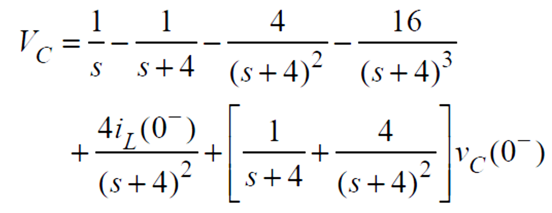
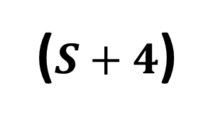
($S+4$)
8
1
8
$$V_{C}\left(t\right)=u\left(t\right)+4e^{−4t}r\left(t\right)−8t^{2}e^{−4t}u\left(t\right)$$

Slide 28
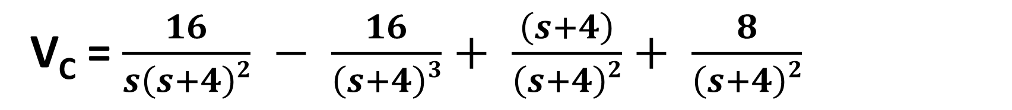
salman
V_{C} = $\frac{16}{s\left(s+4\right)2} − \frac{16}{\left(s+4\right)3}+ \frac{\left(s+4\right)}{\left(s+4\right)2}+ \frac{8}{\left(s+4\right)2}$
VC = $\frac{1}{S}$ - $\frac{1}{s+4} − \frac{4}{\left(s+4\right)2} − \frac{16}{\left(s+4\right)3}+ \frac{1}{\left(s+4\right)}+ \frac{8}{\left(s+4\right)2}$
$$V_{C}\left(t\right)=u\left(t\right)+4e^{−4t}r\left(t\right)−8t^{2}e^{−4t}u\left(t\right)$$

Slide 29


Example -3
Find v_{C} (t) when v_{C} (0− ) = 1 V, i_{L}(0− ) = 1A, i_{in}(t) = 2u(t) A, L = 2 H,R = 2 Ω, and C = 1 F.
Step 1. Draw the equivalent s domain circuit accounting for all initial conditions.
Node a
Node b
$$s$$
$$s$$
Notes:
I cannot find this example in the book. There is a similar one on page 620, example 13.6, but this one can be used. Use example 13.6 as an exercise for students (last slide). Revise the pictures because of the resolution.

Slide 30
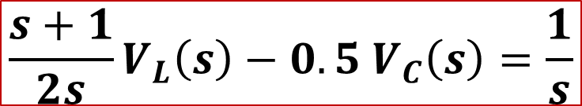
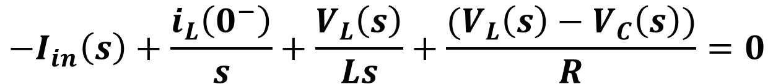
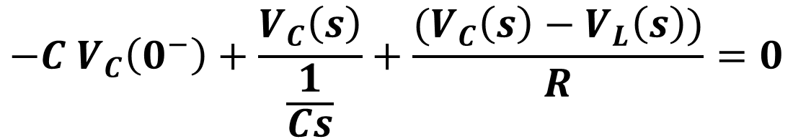
Step 2. Write 2 nodal equations in the s domain
$$−I_{in}\left(s\right)+\frac{i_{L}\left(0^{−}\right)}{s}+\frac{V_{L}\left(s\right)}{Ls}+\frac{{(V}_{L}\left(s\right)−V_{C}\left(s\right))}{R}=0$$
For node a
$$\frac{s+1}{2s}V_{L}\left(s\right)−{0.5 V}_{C}\left(s\right)=\frac{1}{s}$$
$$−{C V}_{C}\left(0^{−}\right)+\frac{V_{C}\left(s\right)}{\frac{1}{Cs}}+\frac{{(V}_{C}\left(s\right)−V_{L}\left(s\right))}{R}=0$$
For node b
$$−0.5 V_{L}\left(s\right)+(s+{0.5) V}_{C}\left(s\right)=1$$

Slide 31
Step 3. Solve the two equations for Vc

Slide 32
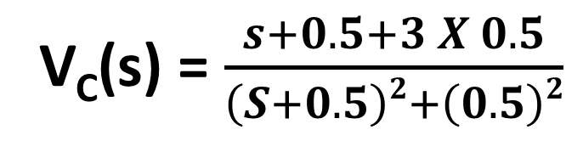

SALMAN
Step 3. Solve the two equations for Vc
$$\left[\begin{matrix}VL \\ VC\end{matrix}\right]= \frac{1}{\left(S+0.5\right)2+\left(0.5\right)2} \left[\begin{matrix}3s+1 \\ s+2\end{matrix}\right]$$
V_{C}(s) = $\frac{s+0.5+3 X 0.5}{\left(S+0.5\right)2+\left(0.5\right)2}$
V_{C}(t) = $e^{−0.5t}\cos\left(0.5t\right)u\left(t\right)+3e^{−0.5t}\sin\left(0.5t\right)u\left(t\right) V$

Slide 33
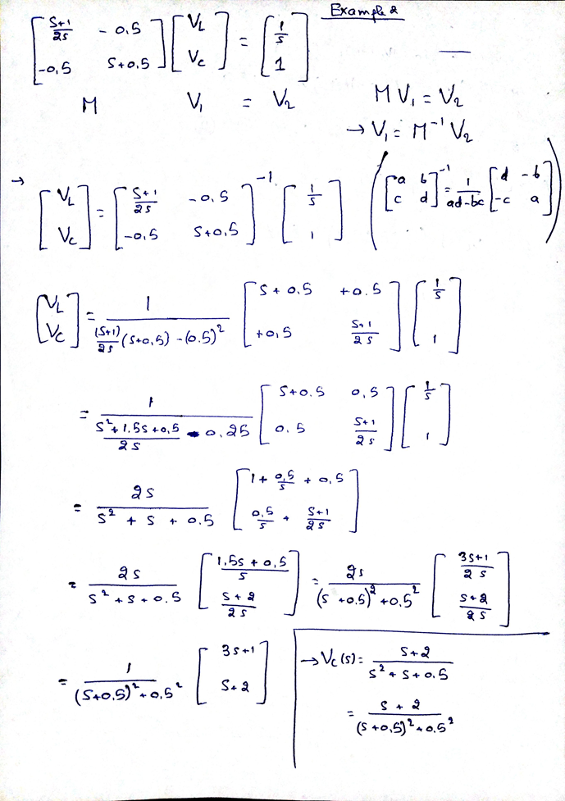
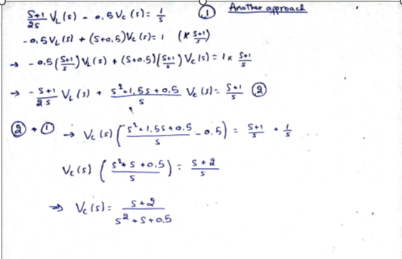

Slide 34
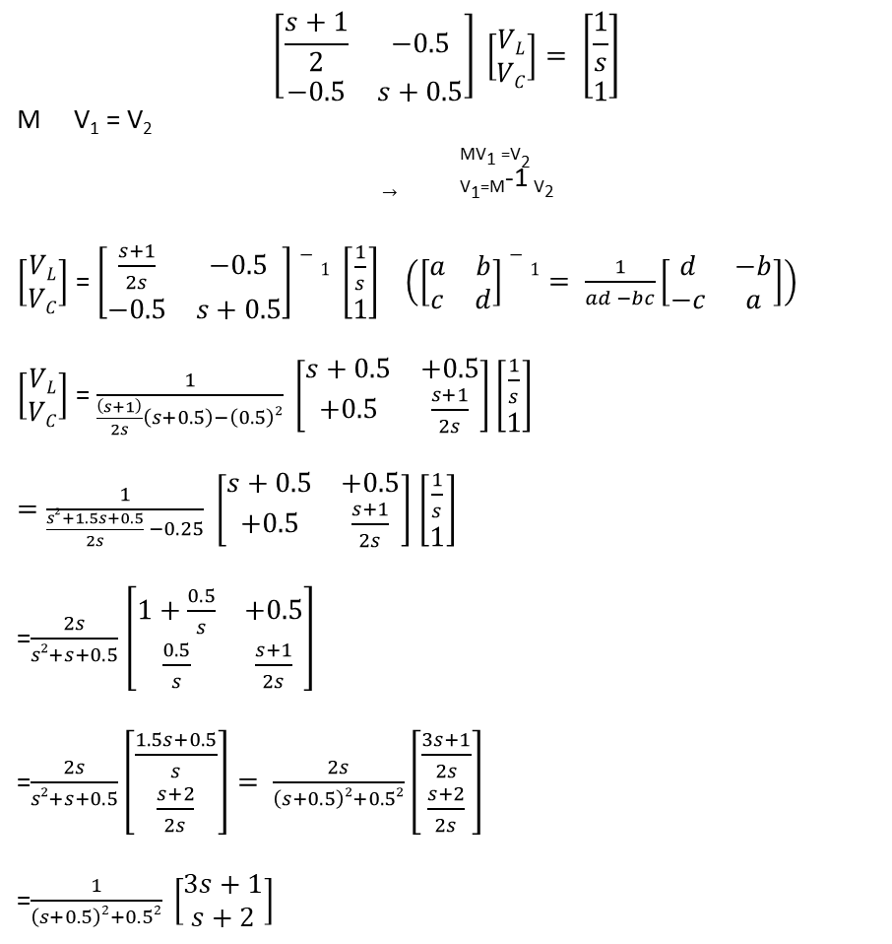
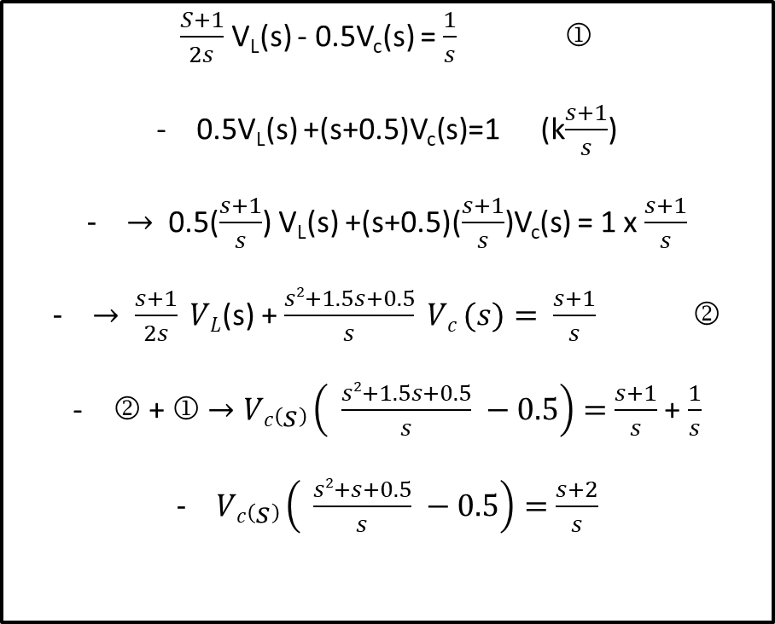

salman
$$\left[\begin{matrix}\frac{s+1}{2} & −0.5 \\ −0.5 & s+0.5\end{matrix}\right] \left[\begin{matrix}VL \\ VC\end{matrix}\right]= \left[\begin{matrix}\frac{1}{s} \\ 1\end{matrix}\right]$$
M V₁ = V₂
_{MV1 =V2}
$→$ _{V1=M}-1 _{V2}
$\left[\begin{matrix}VL \\ VC\end{matrix}\right]$ = $\left[\begin{matrix}\frac{s+1}{2s} & −0.5 \\ −0.5 & s+0.5\end{matrix}\right]−1 \left[\begin{matrix}\frac{1}{s} \\ 1\end{matrix}\right]$ $\left(\left[\begin{matrix}a & b \\ c & d\end{matrix}\right]−1= \frac{1}{ad −bc}\left[\begin{matrix}d & −b \\ −c & a\end{matrix}\right]\right)$
$\left[\begin{matrix}VL \\ VC\end{matrix}\right]$ = $\frac{1}{\frac{\left(s+1\right)}{2s}\left(s+0.5\right)−\left(0.5\right)2} \left[\begin{matrix}s+0.5 & +0.5 \\ +0.5 & \frac{s+1}{2s}\end{matrix}\right]\left[\begin{matrix}\frac{1}{s} \\ 1\end{matrix}\right]$
$=\frac{1}{\frac{s2+1.5s+0.5}{2s} −0.25} \left[\begin{matrix}s+0.5 & +0.5 \\ +0.5 & \frac{s+1}{2s}\end{matrix}\right]$ $\left[\begin{matrix}\frac{1}{s} \\ 1\end{matrix}\right]$
=$\frac{2s}{s2+s+0.5}$ $\left[\begin{matrix}1+\frac{0.5}{s} & +0.5 \\ \frac{0.5}{s} & \frac{s+1}{2s}\end{matrix}\right]$
=$\frac{2s}{s2+s+0.5}\left[\begin{matrix}\frac{1.5s+0.5}{s} \\ \frac{s+2}{2s}\end{matrix}\right]= \frac{2s}{\left(s+0.5\right)2+0.52}\left[\begin{matrix}\frac{3s+1}{2s} \\ \frac{s+2}{2s}\end{matrix}\right]$
=$\frac{1}{\left(s+0.5\right)2+0.52} \left[\begin{matrix}3s+1 \\ s+2\end{matrix}\right]$
$\frac{S+1}{2s}$ V_{L}(s) - 0.5V_{c}(s) = $\frac{1}{s}$ 
0.5V_{L}(s) +(s+0.5)V_{c}(s)=1 (k$\frac{s+1}{s}$)
$→$ 0.5($\frac{s+1}{s}$) V_{L}(s) +(s+0.5)($\frac{s+1}{s}$)V_{c}(s) = 1 x $\frac{s+1}{s}$
$→ \frac{s+1}{2s} VL$(s) + $\frac{s2+1.5s+0.5}{s} Vc (s)= \frac{s+1}{s}$ 
 +  $→Vc\left(s\right)\left( \frac{s2+1.5s+0.5}{s} −0.5\right)=$ $\frac{s+1}{s}$ + $\frac{1}{s}$
$Vc\left(s\right)\left( \frac{s2+s+0.5}{s} −0.5\right)=$ $\frac{s+2}{s}$
$$→Vc\left(s\right)=\frac{s+2}{s2+s+0.5}$$
$$=\frac{s+2}{\left(s+0.5\right)2+0.52}$$

Slide 35
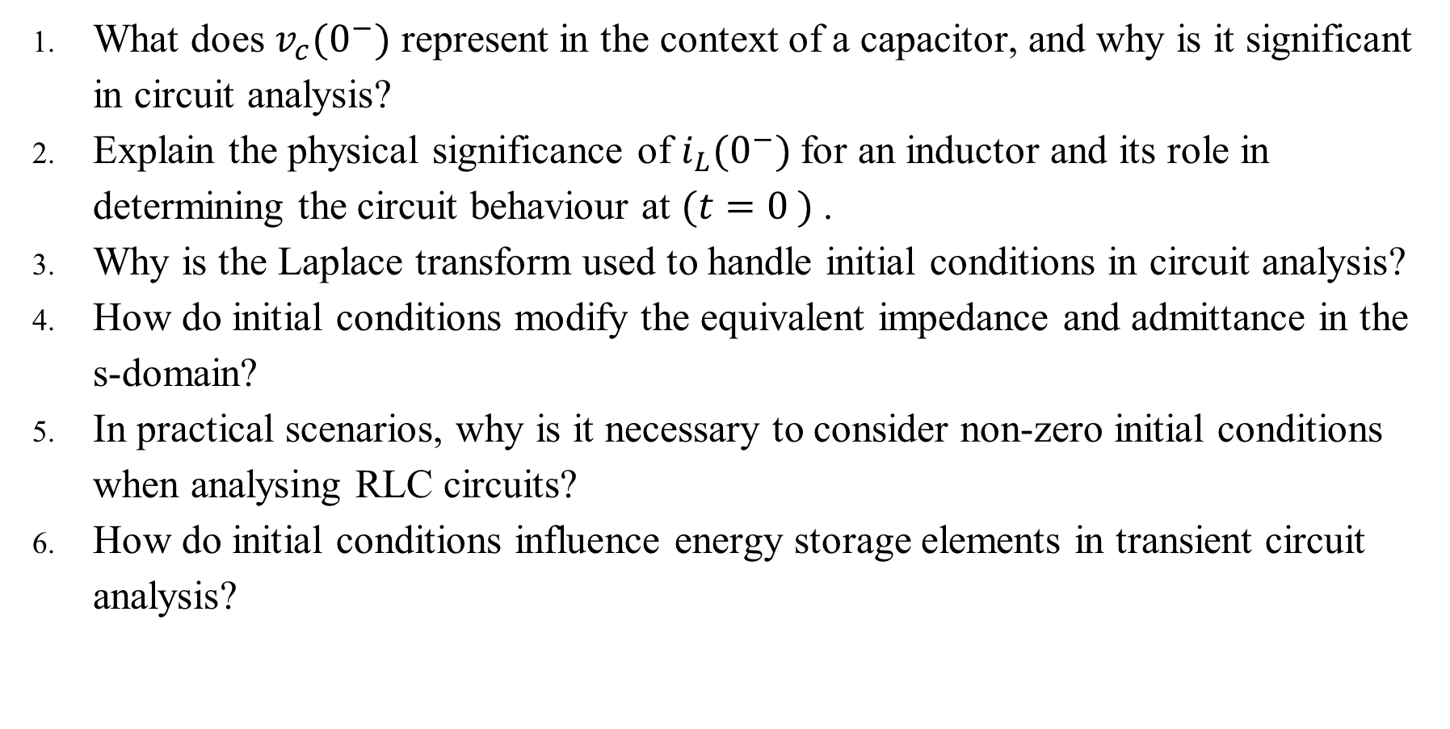
Answer the following questions using ChatGPT
What does $v_{c}(0^{−})$ represent in the context of a capacitor, and why is it significant in circuit analysis?
Explain the physical significance of $i_{L}(0^{−})$for an inductor and its role in determining the circuit behaviour at $({t=0}^{ })$.
Why is the Laplace transform used to handle initial conditions in circuit analysis?
How do initial conditions modify the equivalent impedance and admittance in the s-domain?
In practical scenarios, why is it necessary to consider non-zero initial conditions when analysing RLC circuits?
How do initial conditions influence energy storage elements in transient circuit analysis?

Slide 36
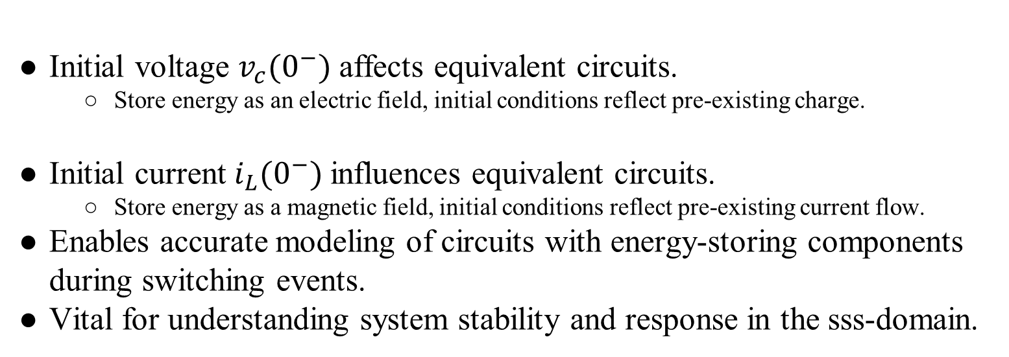
Suggested examples
Summary
Initial voltage $v_{c}(0^{−})$ affects equivalent circuits.
Store energy as an electric field, initial conditions reflect pre-existing charge.
Initial current $i_{L}(0^{−})$influences equivalent circuits.
Store energy as a magnetic field, initial conditions reflect pre-existing current flow.
Enables accurate modeling of circuits with energy-storing components during switching events.
Vital for understanding system stability and response in the sss-domain.
Page 620, example 13.6
Exercise 1, page 623
Exercise 2, page 623

